Slide 1

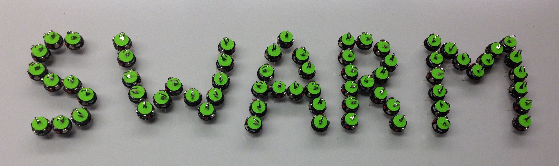
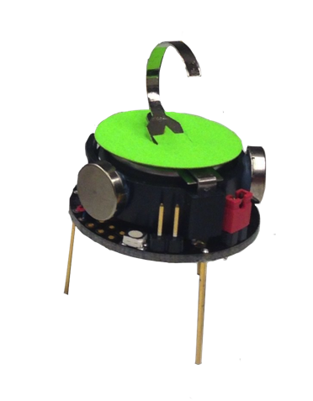






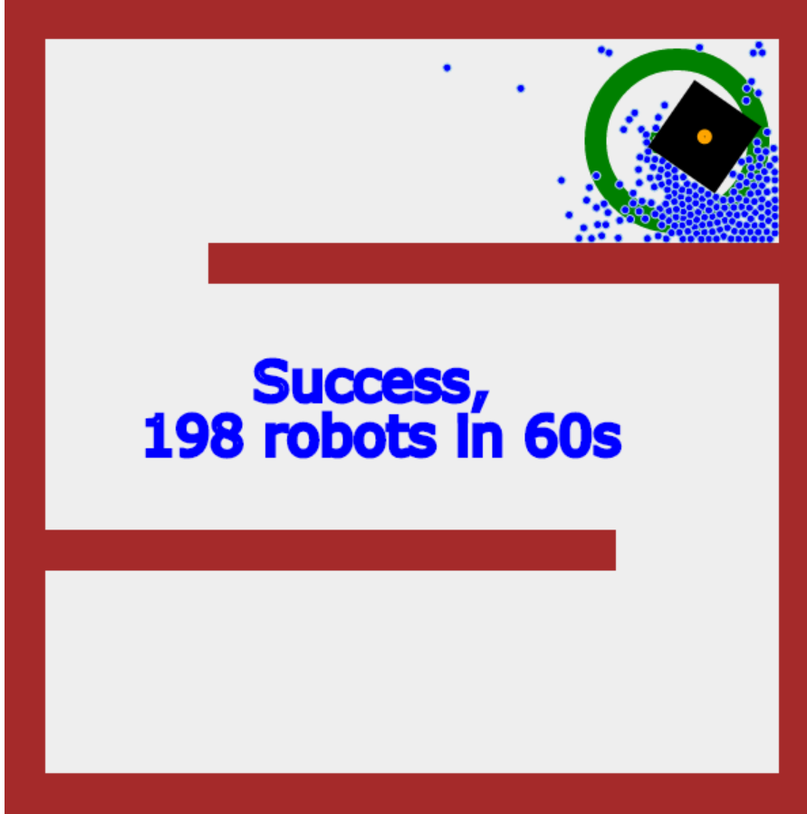
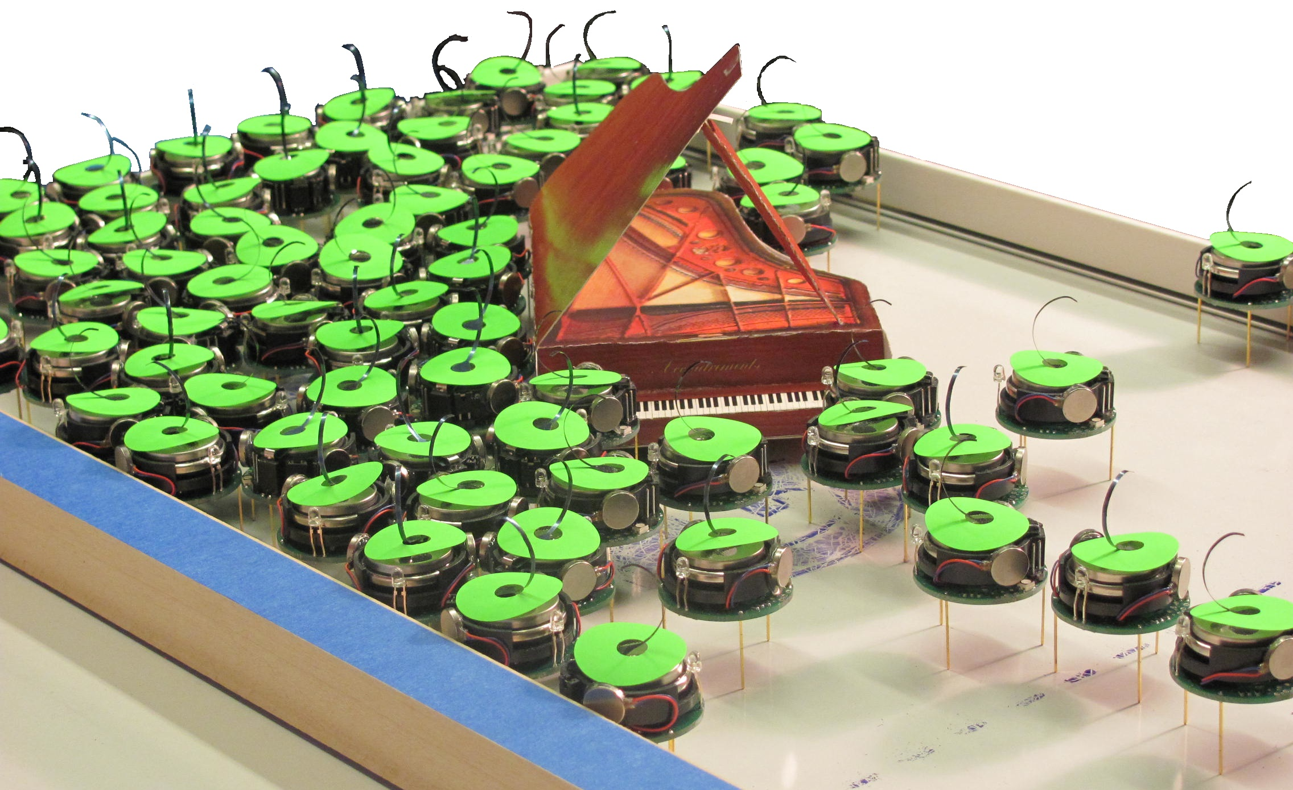
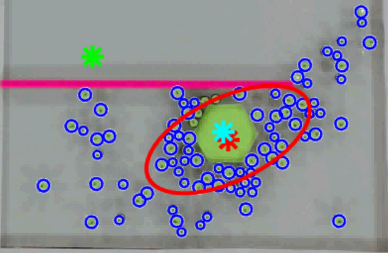
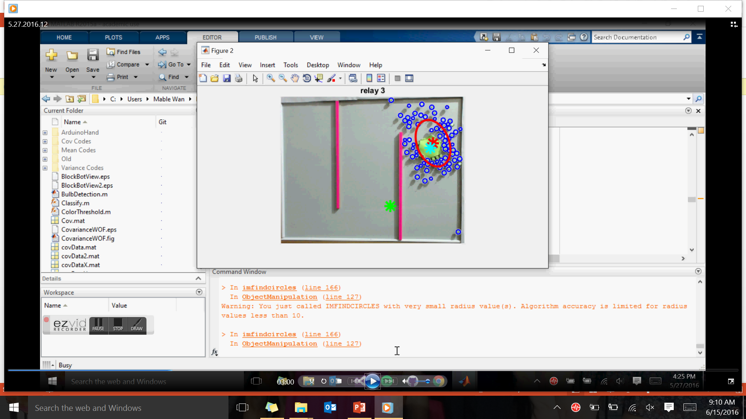
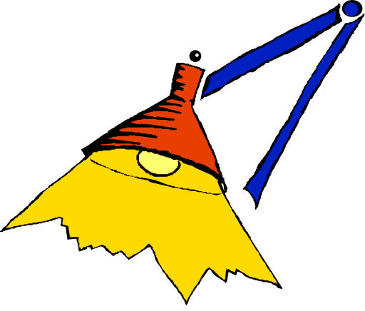
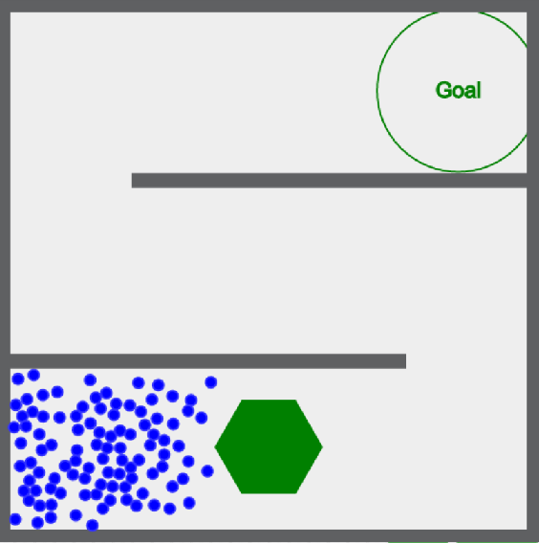
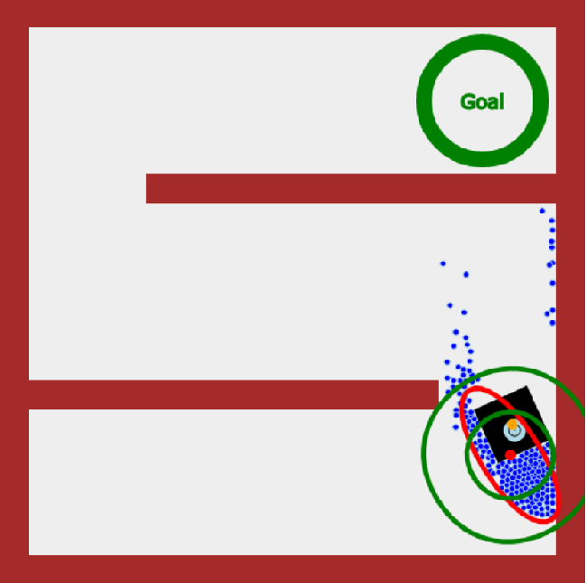
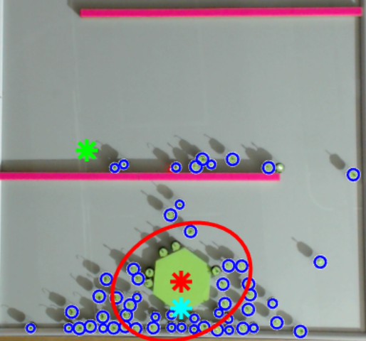
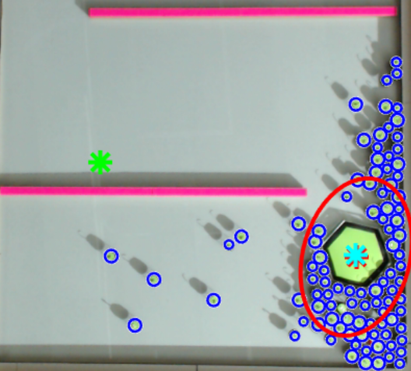
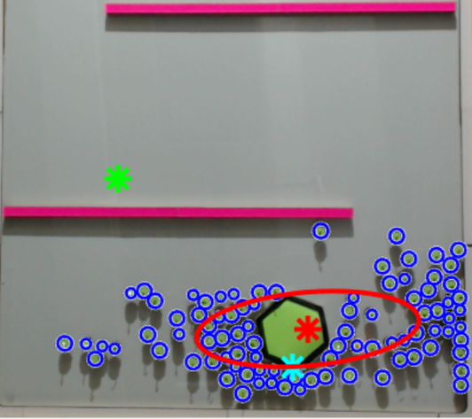
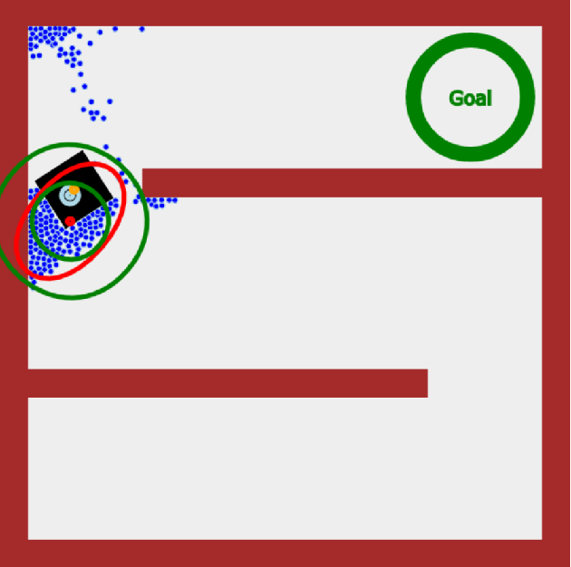

SWARM Object Manipulation with Mean Control
Shiva Shahrokhi, Mable Wan, Lillian Lin, and Aaron T. Becker
sshahrokhi2@uh.edu mmwan2@uh.edu atbecker@uh.edu .
Shiva Shahrokhi Mable Wan
Dr. Becker
Actual Size
What is SWARM?
Problem #2
Results
SWARM is 100+ kilo-bots moving an object to a desired location. All robots have the same “brain”, aka program, and respond to the same global inputs, lights.
Advantages of SWARM:
Can pass through tight structures
Can bend around obstacles
Affordable to replace the robots
Control variables: Mean and Variance
Centroid Matching
False goal completion
Robots surround the object
Ambiguous directional planning
Success!
Increased probability
of reaching the goal
Reduced noise for
calculating desired
direction for robots
Decreased chances of
the block getting stuck
Local Goal
Mean
Robot Direction
Solution
Local Mean Control
Consider only relevant robots
Conclusions
Mean
Object’s
Centroid/ Local Goal
Method
Calculates the mean of the robots within a certain radius, the relevant robots.
Obstacle Considerations
are Necessary
Obstacles can decrease
robot’s effectiveness
Local Controls are
More Effective
Peripheral controls
cause noise and skew data
Variance
Irrelevant Robots
Problem #1
Irrelevant Robots
Robots in front of the object
Relevant Robots
Mean calculations do not include:
Robots are stuck behind obstacles
Robots are in front of object
Blocks object from moving in desired direction
Pushes object backwards
Irrelevant
Robots
Relevant Robots
Games
Play games for our research!
Irrelevant Robots
Mean

